Slide 1

Kinder Finder
Uteshlen Nadesan 28163304 Team Leader
Michael Johnston 12053300
Po-Han Chiu (Arthur) 11063612

Slide 2
Project Vision
Many restaurants aim to give parents a worry free dining experience
However, a parent still has the worry
They have a consistent need to ensure their children are still in the safe and designated areas
This solution will attempt to assist the parents in being able to make sure their children are still in these areas without the need to get up from their tables

Slide 3
Implementation Details
Using Bluetooth technology to track the whereabouts of children in a designated area (e.g. children’s play area)
Receivers located around designated areas
Transmit to local server which transmits to cloud server
Reports location to mobile app
Parents can view children’s location on map

Slide 4
System Modules
Web Administration
Basic Reporting
Mobile Application
Web API
Embedded Hardware and prototyping (POC).
Nice-to-have (unless we finish implementation early)

Slide 5
Reporting Module
Available through the web portal to system administrators
It will provide statistics such as:
Which zones are used the most
How often specific customers use the service
Whether any of the hardware devices are broken or malfunctioning

Slide 6
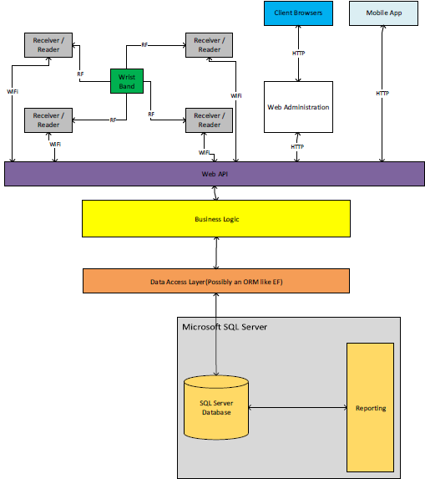
System Architecture

Slide 7
Technologies
Programming Language (Primary)
C#
Database
SQL Server Express 2012
Data Access Layer
Entity Framework (ORM)

Slide 8
Technologies
Web Development
ASP.NET MVC 5
WebAPI 2.2
IDEs
Microsoft Visual Studio 2013 Professional
Xamarin Studio

Slide 9
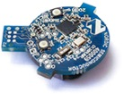
Hardware
Previously: Radio Frequency
Now: Bluetooth 4
nRF51822
20mm diameter
Firmware
Android source code

Slide 10
Hardware
Intended usage
Beacon on painting
Bring phone close to painting
App tells you about it
Our usage
Cheap phones positioned around room
Beacons move around (on children)
Phones relay information to server

Slide 11
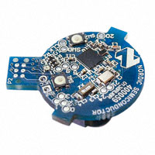
Hardware
We have decided to switch from RFID’s to Bluetooth technology
Reason for the change
Cost
Wider signal range
Receivers are readily available
Prototyping can be done with minimal cost
NRF51822-BEACON

Slide 12
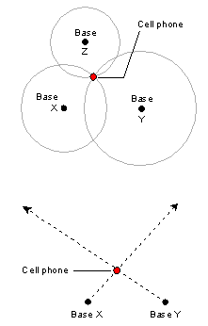
Technologies
Triangulation
Determined by measuring either the radial distance,
or the direction, of the received signal from two or three different points.
Bluetooth transmitters also provide signal strength which we will calibrate to use with our project.

Slide 13
Demo User Details
Administration Portal
Username: admin
Password: Password1!
Android App
Email Address: mrbean@gmail.com
Password: computer

